Slide 1
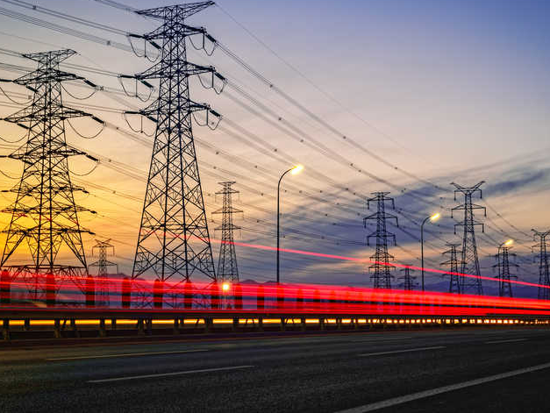
Capstone 2 Great Energy Predictor
Jingling Zhang

Slide 2

Background
There are two key elements to develop energy saving: first we need to be able to forecast future energy usage without improvement, and we also need to predict energy use after a specific set of improvement have been implemented. One issue hindering the growth of energy markets are the lack of cost-effective, accurate and scalable procedures for forecasting energy use.
The best we can do is to build counterfactual models.

Slide 3

Potential Clients
Large scale investors and financial institutions will be more inclined to invest to enable progress in building efficiencies with better estimates of energy saving investiments

Slide 4
Data source
https://www.kaggle.com/c/ashrae-energy-prediction/data
Data across four energy types based on historic usage rates and observed weather were collected. This dataset includes three years of hourly meter readings from over one thousand buildings at several different sites around the world.

Slide 5
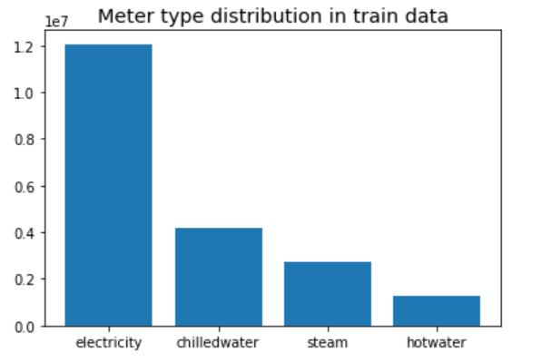
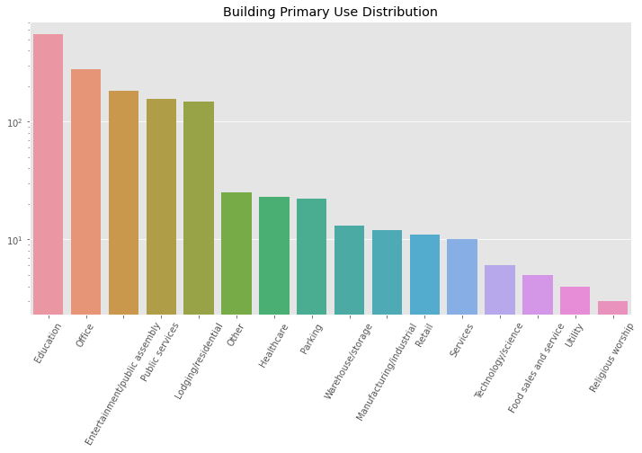
Exploratory Data Analysis

Slide 6
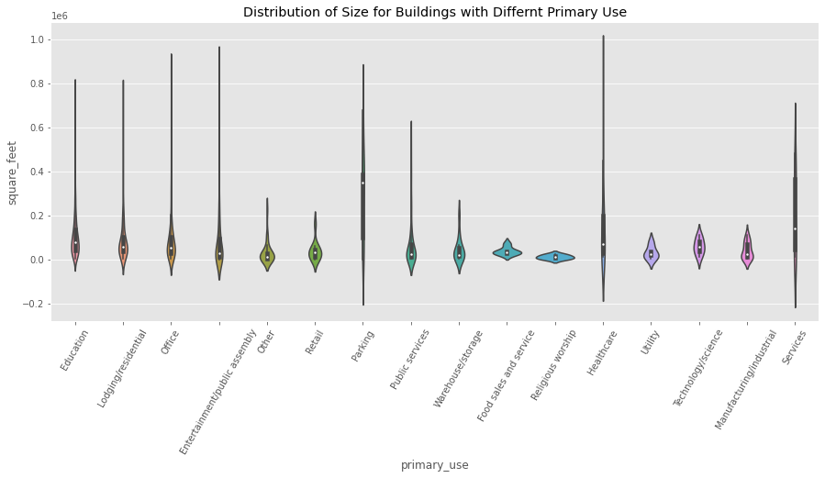

Slide 7
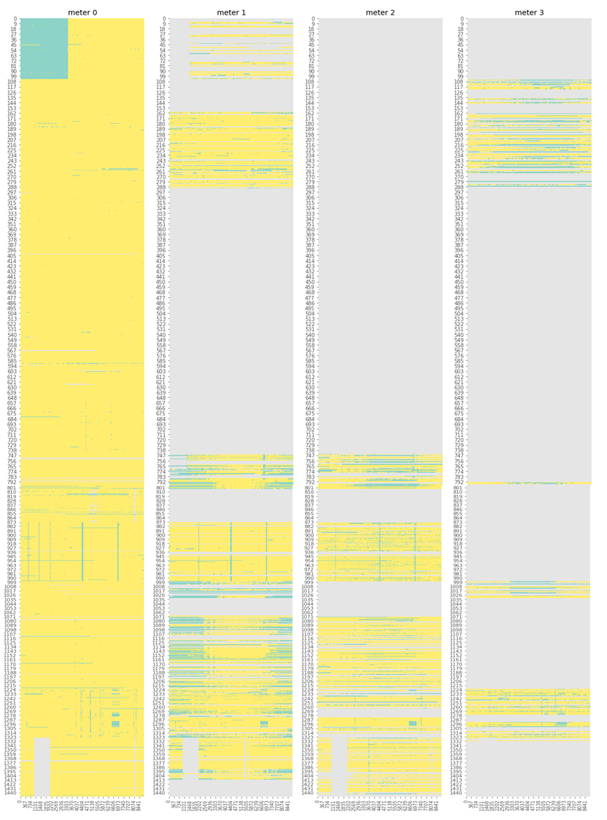

Slide 8
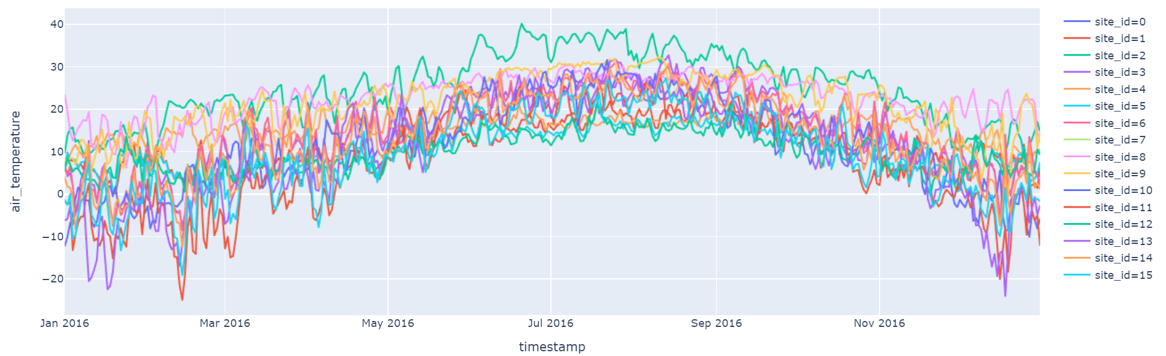
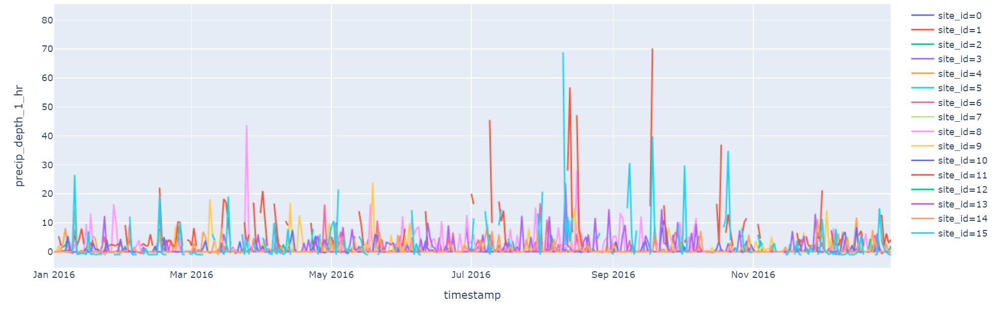

Slide 9
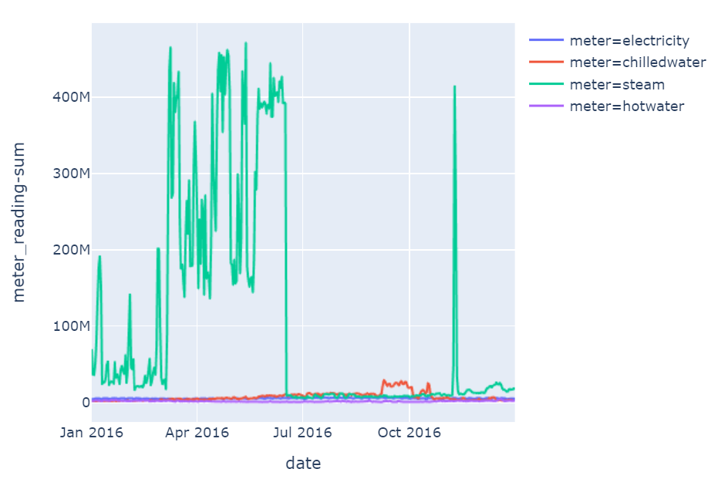
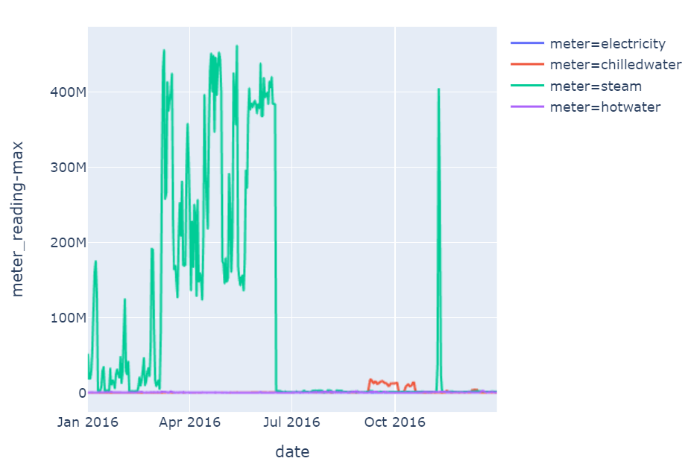

Slide 10
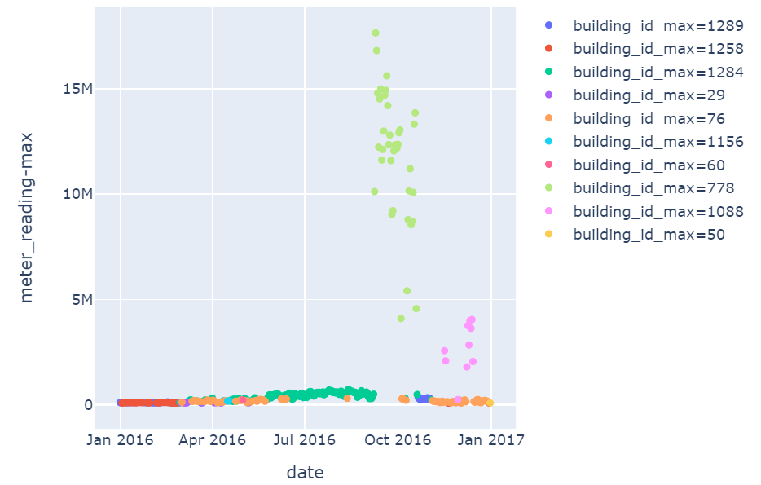

Slide 11
Data Wrangling
Fixing wrong data
Removing outliers
Handling missing values
Handling zero-readings

Slide 12
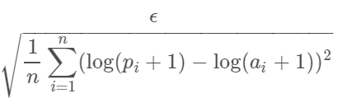
Data Modeling
Evaluation metric RMSLE
ϵ is the RMSLE value (score)
n is the total number of observations in the (public/private) data set
p_{i} is your prediction of target
a_{i} is the actual target for I
log(x) is the natural logarithm of x

Slide 13
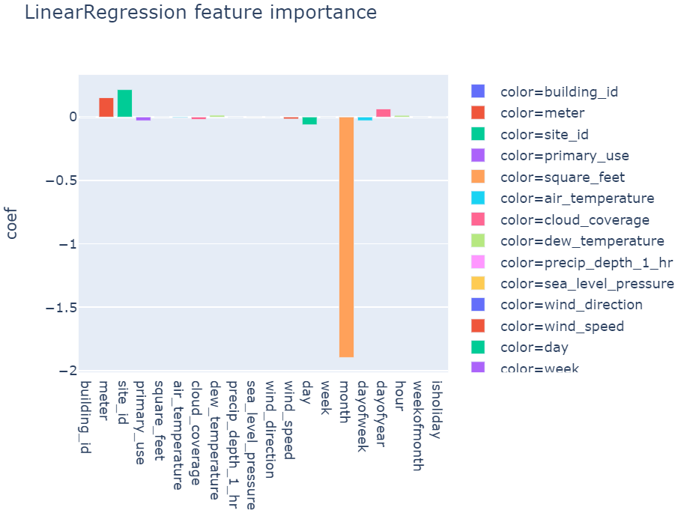
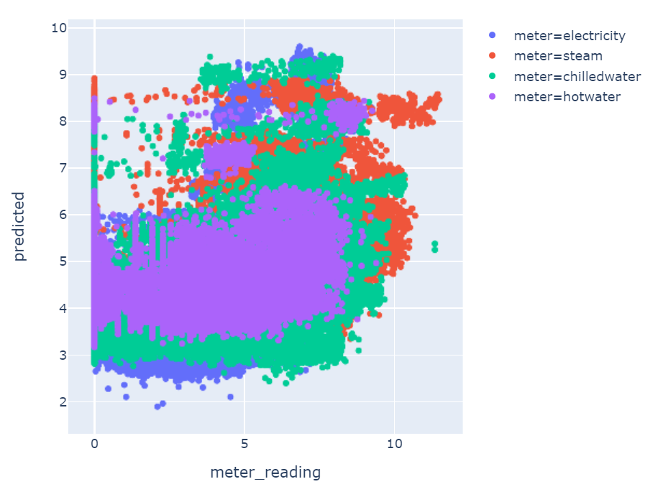
Benchmark model
Score for training data: 1.832
Score for testing data: 1.833

Slide 14
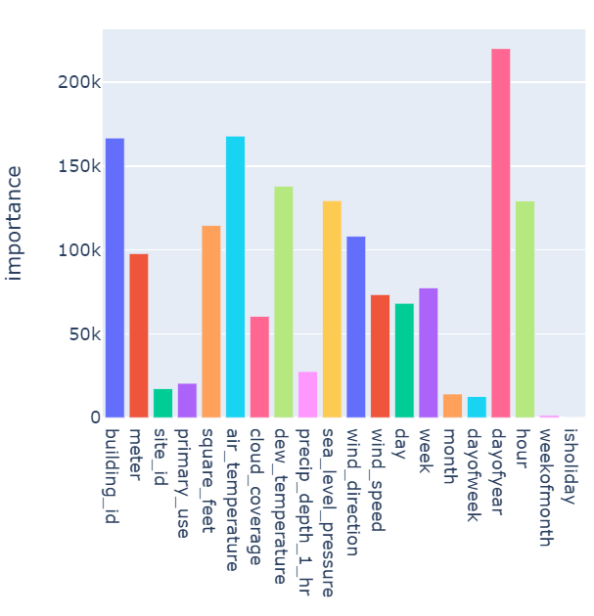
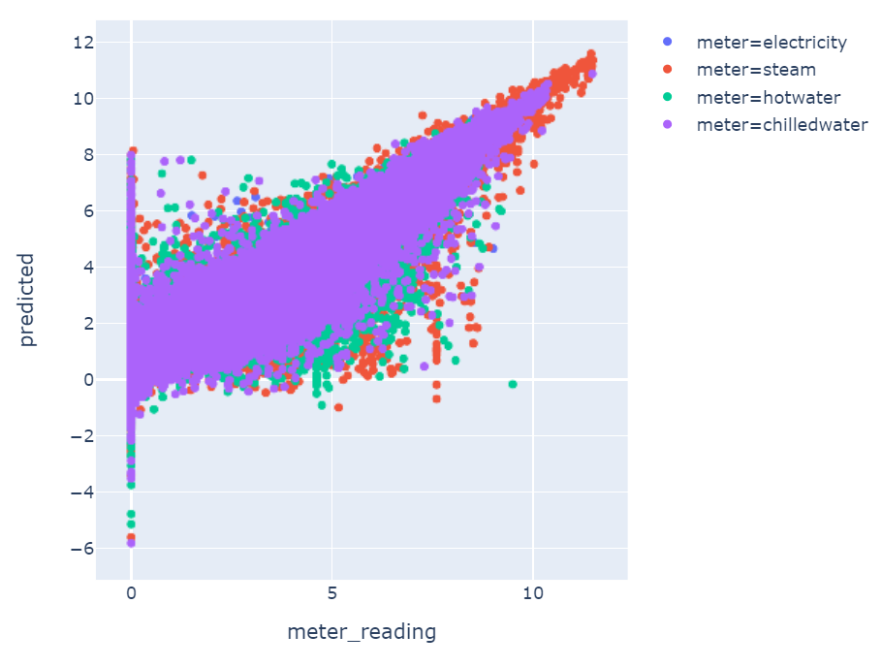
Light GBM model
Score for training data: 0.300
Score for testing data: 0.454

Slide 15
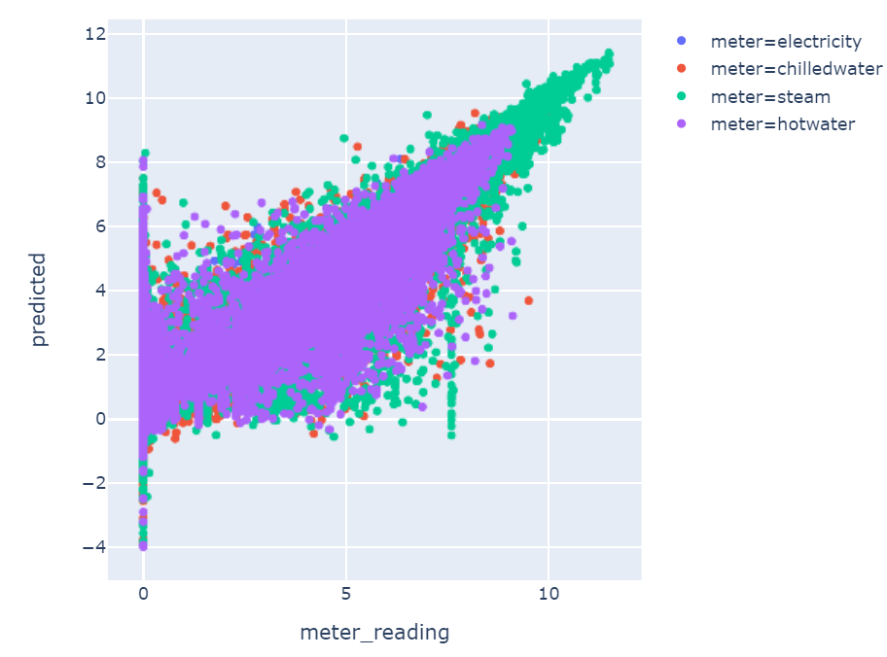
Half-half model
Score for training data: 0.351
Score for testing data: 0.469

Slide 16
Performance of models after refining data and tuning hyperparameter
Score | Training data | Testing data
Light GBM model | 0.47 | 0.50
Half-half model | 0.52 | 0.52

